Slide 1
Meaning and Definition of Marketing Mix?
Meaning:- Marketing mix means of Combination of
“4 Ps” i.e. Product, Price, Place & Promotion
Definition:- In 1960, E. Jerome McCarthy defines
“The basis of Marketing operations is the co-ordination of four key variables, namely : Product, Price, Place and Promotion”.
( Way to remember :- -co-ordination of four key variables, )

Slide 2
Welcome to all
for the MHRM Online lecture
By
Dr. Dhiraj Ovhal
HOD of Commerce

Slide 3
Chapter -3
Marketing Decision –II
(Place and Promotion)

Slide 4
Q.2. Channels of Distribution:-
MEANING OF DISTRIBUTION CHANNELS
William Stanton defines “A channel of distribution is the route taken by the title to the product as it moves from the producer to the ultimate consumer or industrial user."
Basically Two channels of Distribution like 1….Traditional Channel and
2….Recent /Contemporary /New channels of distribution

Slide 5
Q.2. Channels of Distribution:- Traditional Methods
Direct Marketing Channel –
where the manufacturer directly sells to the final consumer without the help of intermediaries.
Indirect Marketing Channels –
where the manufacturer sells to the final consumer with the help of intermediaries.

Slide 6
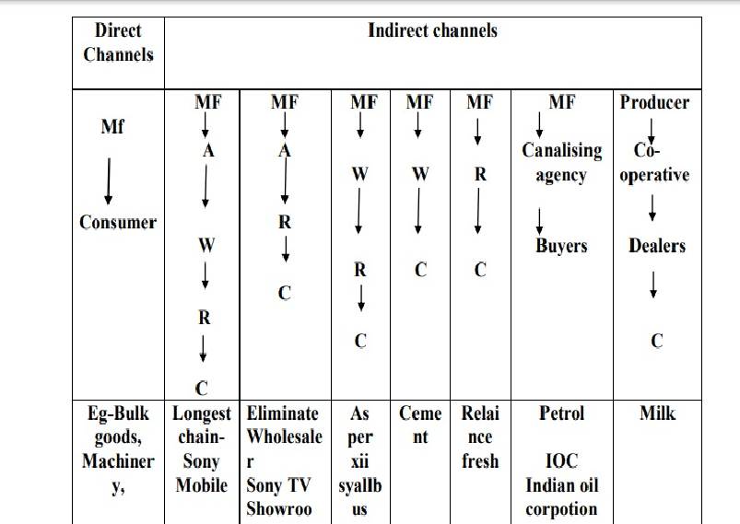

Slide 7
1. Direct Channel of Distribution (Manufacturer - Consumer):
The direct channel of distribution is also known as zero-level marketing channel. In the direct channel there are no intermediaries between the producer and the final buyer. The producer sells directly to final buyers through his own network of stores or at a centrally located place or by appointing door-to door sales-force.

Slide 8
Reasons for direct selling:
The producers can have greater control over the distribution of their products. Non-availability of middlemen or reluctance from middlemen to stock the goods.
Producers of heavy/bulky goods transport directly to the final buyer, to reduce handling and transport costs.
Producers that cater to a few customers may sell directly.
Complex or high-tech products which require good after sales-service may directly sell to the final buyers.
Producers who wish to have direct contact with their final buyers to get first hand information.
Producers who sell through the internet do not require intermediaries.
Small business establishments like hotels, bakeries etc., can conveniently sell directly to local customers.

Slide 10
Thank You

Slide 11
Attendance Link
https://forms.gle/Xqvykv5vfEi1zpyF7
(Mention date at last point)

